Slide 1
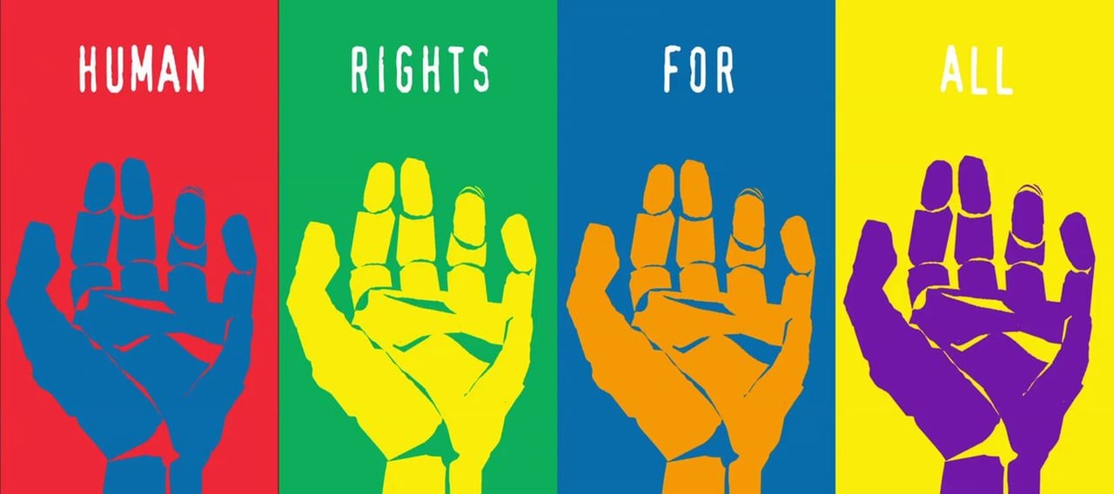
Human Rights
“Formando hombres y mujeres: dueños de su propio destino”
English Department
Miss Deborah Aguirre

Slide 2
What are human rights?
Human rights are the basic rights and freedoms that belong to every person in the world, from birth until death.
They apply regardless of where you are from, what you believe or how you choose to live your life.
They can never be taken away, although they can sometimes be restricted – for example if a person breaks the law, or in the interests of national security.

Slide 3
What are human rights?
These basic rights are based on shared values like dignity, fairness, equality, respect and independence.
These values are defined and protected by law.
There are 30 Human rights, go to the following link to know them:
https://www.youthforhumanrights.org/what-are-human-rights/universal-declaration-of-human-rights/articles-1-15.html

Slide 4
How do human rights help you?
Human rights are relevant to all of us, not just those who face repression or mistreatment.
They protect you in many areas of your day-to-day life, including:
your right to have and express your own opinions
your right to an education
your right to a private and family life
your right not to be mistreated or wrongly punished by the state

Slide 5
Where do human rights come from?
The idea that human beings should have a set of basic rights and freedoms has deep roots in Britain.
Landmark developments in Britain include:
the Magna Carta of 1215
the Habeas Corpus Act of 1679
the Bill of Rights of 1689

Slide 6
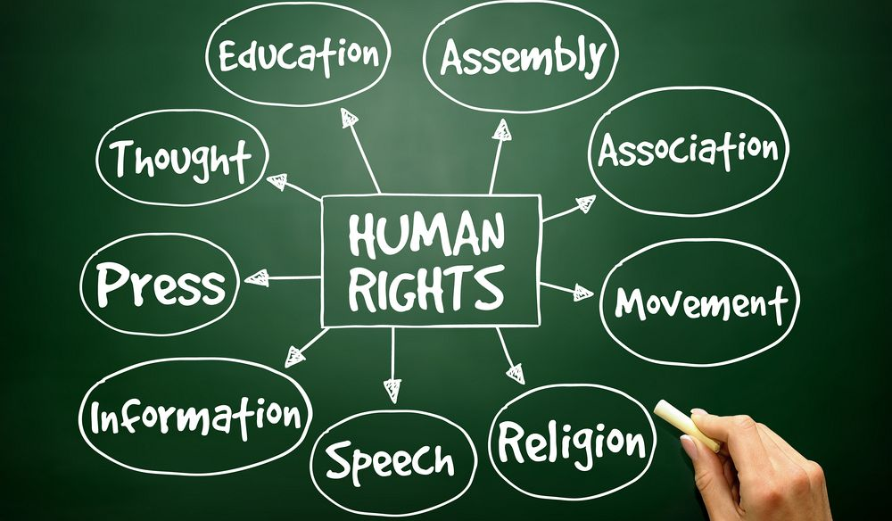
Watch the following video related with Human Rights:
https://www.youthforhumanrights.org/what-are-human-rights/
Now, complete the worksheet attached.

